Slide 1

Module 02
Operating Systems

Slide 2
Exam Objective
1.1 Linux Evolution and Popular Operating Systems
Objective Description
Knowledge of Linux development and major distributions

Slide 3
Exam Objective
4.1 Choosing an Operating System
Objective Description
Knowledge of major operating systems and Linux distributions

Slide 4
Introduction to Operating Systems

Slide 5
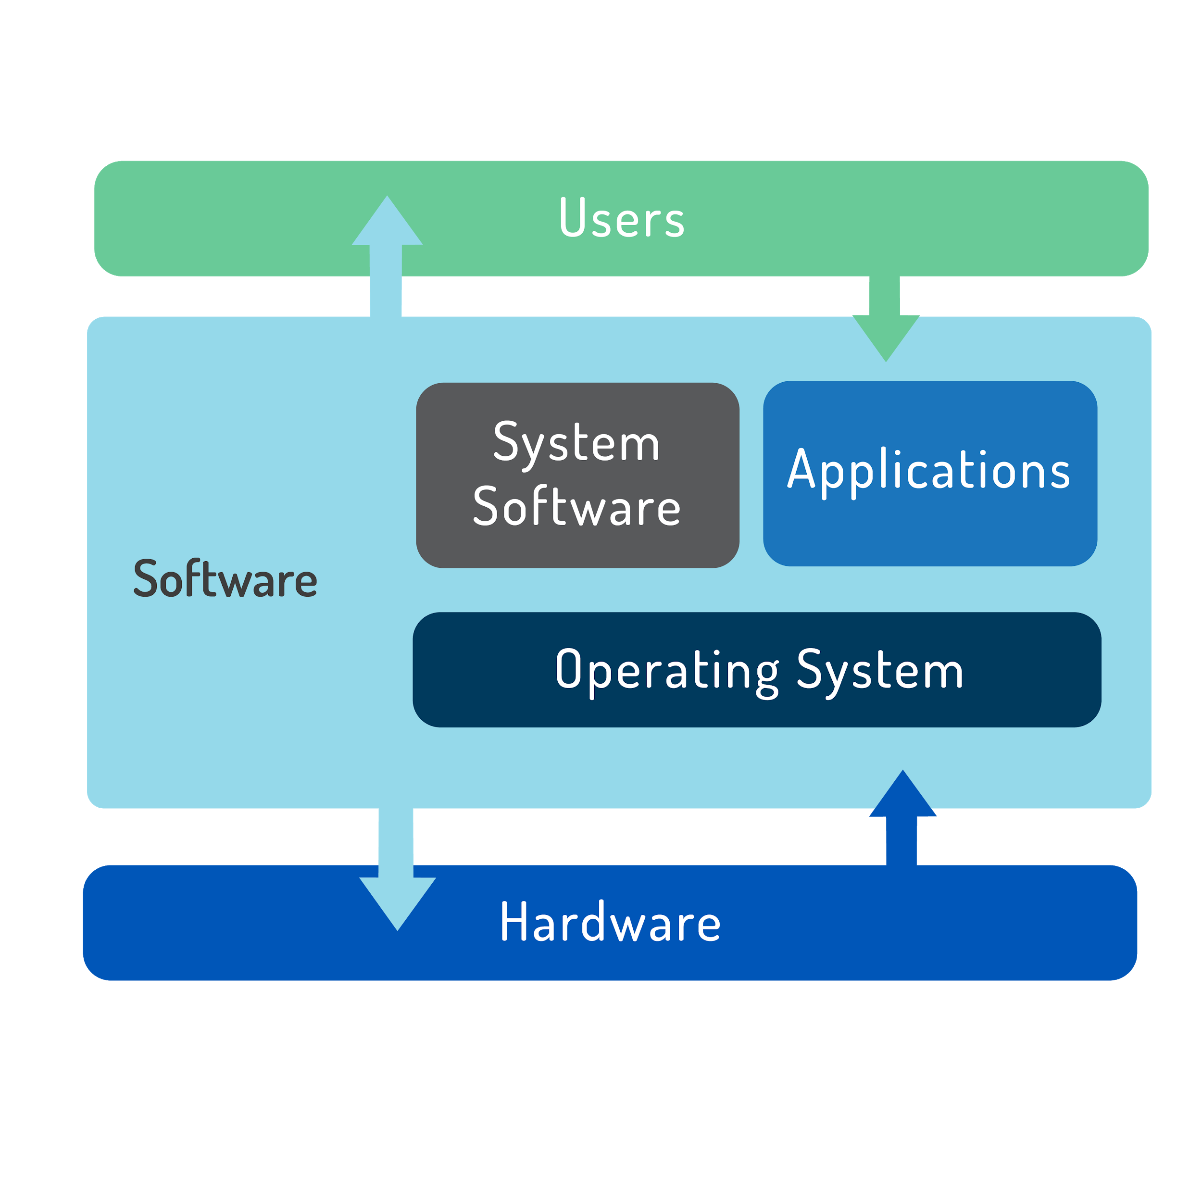

Operating System
Software that runs on a computing device and manages the hardware and software components that make up the system.
It also schedules programs to run and provides services to users or programs (i.e., print).
Commonly abbreviated as OS

Slide 6

Operating Systems
Users today have a choice between three major operating systems:
Microsoft Windows
Apple macOS
Linux
Only Microsoft Windows is based on proprietary code that is not Unix or Linux based.

Slide 7
Decision Points
Role: Accessed by one user directly (desktop) or many users remotely (server)?
Function: Does it need to run specific software? What is the skill set of users?
Life Cycle: What is the service lifetime? OS types have different release cycles and maintenance cycles for support and updates.
Stability: Are OS releases beta (not tested “in the wild”) or stable (tested)?
Compatibility: Is it backwards compatible as in is it compatible with software made for earlier versions?

Slide 8
Decision Points
Cost: Important factor for new systems.
Microsoft has annual license fees.
Apple does not charge annual fees but only works on Apple hardware.
There are multiple Linux providers who offer enterprise support and although the software is free, support is not.

Slide 9
Microsoft Windows
Offers desktop and server versions.
Slow release cycle (3-5 years), long maintenance cycle
Emphasis on backward compatibility
Runs a Graphical User Interface (GUI)
Improved scripting and management abilities are being developed to compete with Linux.

Slide 10
Apple macOS
Runs only on Apple hardware
Server version adds packages to the desktop version to aid in management and sharing.
UNIX certified
New major releases every 18-24 months

Slide 11
Linux
Unique in that after choosing Linux you must choose a distribution
Different distributions focus on different use cases, e.g. desktop, server, scientific, network
Some distributions offer commercial support, most is volunteer based

Slide 12
Linux Decision Points
Role: Distributions available for variety of systems; commercial for servers and desktop, specialized to repurpose computers, embedded systems, etc.
Function: Distributions can be chosen based on purpose of usage or security needed.
Life Cycle: Most distributions have major and minor update cycles. Some Linux releases have long-term support (LTS) (5+ years, 13yrs for SUSE LTS ).
Stability: Some distributions offer stable, testing, and unstable releases.
Compatibility: Distributions are zero cost. Depending on need, paying for support may be worthwhile. Enterprise users can pay for support or attempt self-support.

Slide 13
Linux Distributions

Slide 14
Red Hat
Focuses on server applications like web and file serving.
Releases Red Hat Enterprise Linux (RHEL), a stable distribution with long release cycles.
Sponsors the Fedora Project, a personal desktop with latest software.
CentOS is a free version of RHEL software which does not offer support.
Scientific Linux is a specific use distribution based on Red Hat.

Slide 15
SUSE
One of the first distributions
Originally derived from Slackware
Contains proprietary code and is sold as a server product. Some modules or addons may contain proprietary code.
Sold as a server product although a Workstation version exists.
OpenSUSE is a completely open, free version with multiple desktop packages.

Slide 16
Debian
Community effort that promotes use of open source software.
Invented its own package management system (apt) based on the .deb file format.
Ubuntu is its most popular derived distribution, which has variants for desktop, server, and applications. Ubuntu also offers an LTS version.
Linux Mint is a derivative of Ubuntu with various free versions, some have license restrictions.

Slide 17
Android
Provides a platform for mobile users.
Lacks traditional GNU/Linux packages to make it compatible with desktop.
Sponsored by Google

Slide 18
Other Linux Distributions
Raspbian is a Linux distribution designed to run on Raspberry Pi hardware.
Linux From Scratch (LFS) consists of an online book, source code, and instructions for building a custom Linux distribution.
Can be used as learning tools.

